Slide 1
Real-Time Task Scheduling in Multiprocessor and Distributed Systems
:
Chapter 4
RAJIB MALL
Professor
Department Of Computer Science & Engineering
IIT Kharagpur.

Slide 2
Organization
  Introduction
  Real-Time task scheduling
    Clock-driven
    Event-driven
  Scheduling of real-time task on a uniprocessor
    Rate Monotonic Analysis (RMA)
    Earliest Deadline First (EDF)
    Scheduling with limited priority levels
  Resource sharing among tasks
    Priority inversion problem
    Priority inheritance protocol

Slide 3
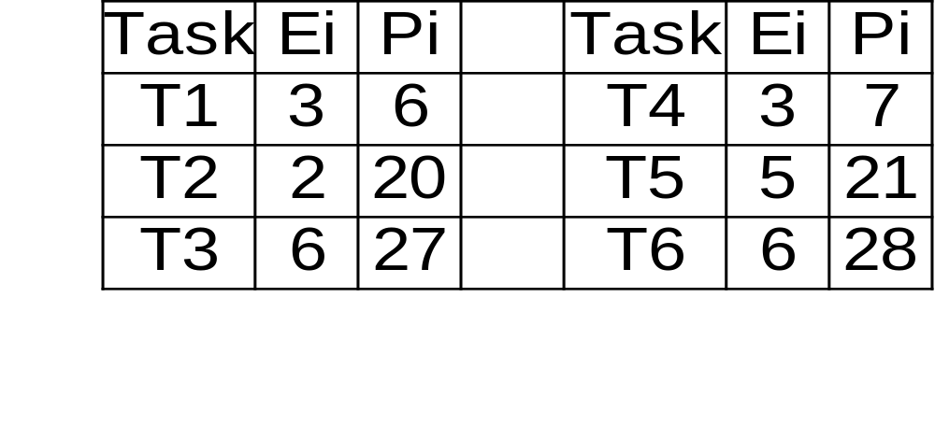
Example

Slide 4
Multiprocessor and Distributed Systems
Multiprocessor and distributed systems are becoming popular
Broadly, there are two types of solutions:
  Static: Tasks are statically assigned to processors
  Dynamic: The processor which would execute a task is dynamically decided.
Almost all multiprocessor/distributed system-based real-time systems built to date are static

Slide 5
The Scheduling Problem
Task assignment problem:
  How to assign tasks to processors?
Scheduling problem:
  How to schedule the tasks on the processor to which it has been assigned.

Slide 6
Important Algorithms
Utilization balancing algorithm
Next-fit algorithm for RMA
Bin packing algorithm for EDF
Focused addressing and bidding algorithm
Buddy algorithm

Slide 7
Summary
Task scheduling in multiprocessor and distributed systems
  much more complex than uniprocessor scheduling
Scheduling consists of two sub-problems:
  task allocation to individual processors
  task scheduling at the individual processors.
Task allocation is an NP-hard problem.

Slide 8
Summary
In a distributed real-time system, it is vital to have all the clocks in the systems synchronized.
Centralized clock synchronization is susceptible to single point failure.
A distributed clock synchronization scheme can keep the good clocks in a distributed system synchronized
  only if no more than 25% of the clocks are bad or Byzantine.

